Slide 1
YAN AND NITROGEN in wine & the vine
TAKE HOME CONCEPTS
1. In terms of wine making, nitrogen is considered second only to sugar in importance.
2. Without nitrogen – but with sugar (fuel) – wine yeast will reproduce for a short time but growth will be irregular --> (stuck fermentation) then growth will stop altogether.
3. Without nitrogen, grape vines would never produce grapes. (Nitrogen is essential for protein formation.)
4. With too much nitrogen, growth (vines & yeast) can be irregular.

Slide 2
-THE IMPORTANCE OF NITROGEN IN WINE AND TO WINE GRAPES – (talking points)
Why nitrogen is important to wine grapes.
Why nitrogen is important in wine fermentation.
Can YAN provide a “fingerprint” for grape quality?
Can the YAN of today’s grapes be used to select grapes in the future?
Problems with inadequate or too much nitrogen.

Slide 3
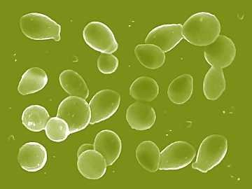
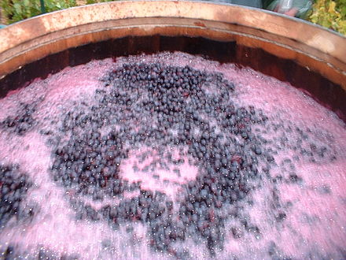
YAN stands for Yeast Assimilable Nitrogen.
25-60% nitrogenous substances
Free Amino Nitrogen – FAN
Ammonia – NH₃ ,
Ammonium – NH₄
ML BACTERIA ALSO REQUIRE NITROGEN

Slide 4
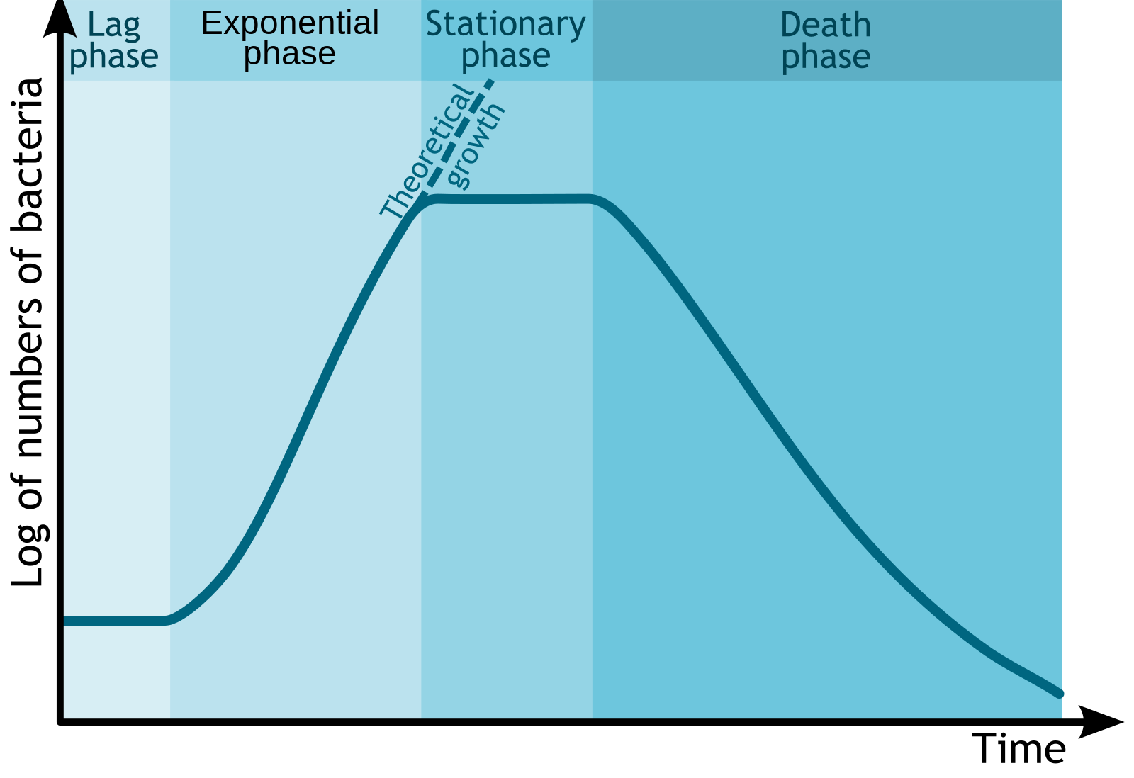
Cell numbers →
Growth Curve
Time →
Yeast growth usually occurs in four different phases:
A, Lag phase,
B. Log phase,
C, Stationary phase,
D. Death phase.

Slide 5
Nitrogen is most critically needed by yeast during the period of early cell growth through log phase and early stable development.
Nitrogen is most critically needed by grapevines during the period of rapid shoot growth in the spring through bloom and early berry development.

Slide 6
YAN is a yeast value – it is different from nitrogen status for grape vines in the vineyard.
(yeast needs differ from plant needs)
Chris Gerling,
Enology Extension Associate,
Cornell University

Slide 7
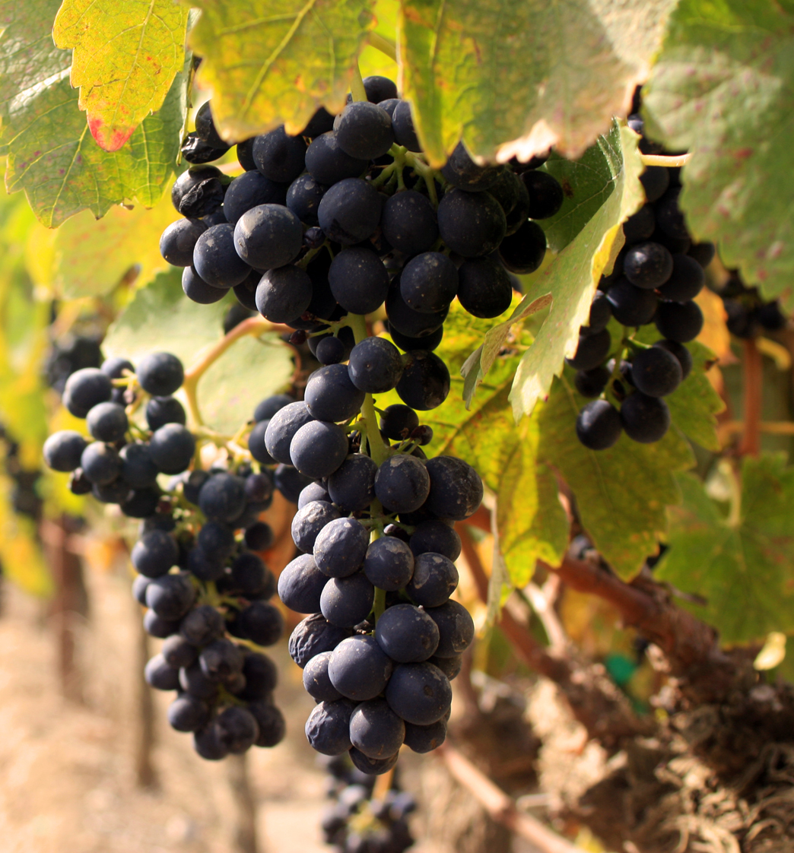
As a result, the management for each is different
- at least so far-

Slide 8
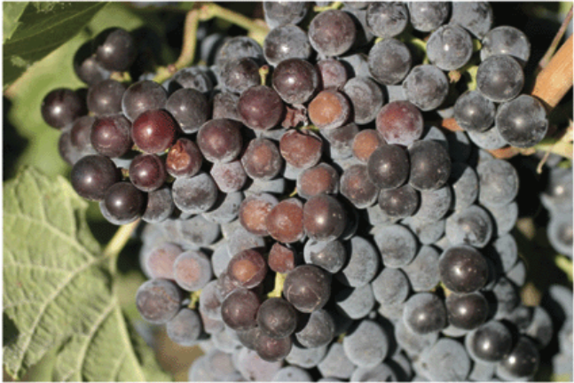
CAB SAUV –
SUNBURN & EXCESS NITROGEN

Slide 9
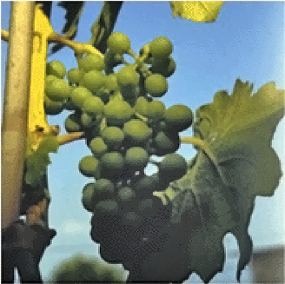
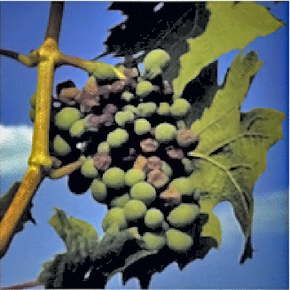
GRAPES GROWN ON HIGH
NITROGEN SOILS ARE MUCH
MORE SUSCEPTIBLE TO
SUNBURN
PHOTOS BY M. KELLER (WSU)

Slide 10
Marcus Keller, Washington State University Prosser, WA
The effect of nitrogen on yield and fruit quality depends on the nature of the grape growing region,
soil type and composition, and prevailing
weather conditions.
the site terroir influences the ability to manipulate the yield-quality relationship in grapes using nutrient and water management or other cultural practices.

Slide 11
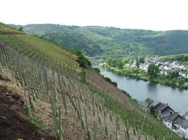
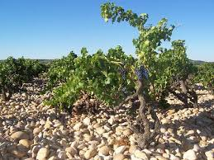
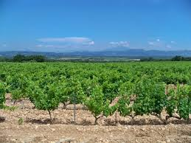
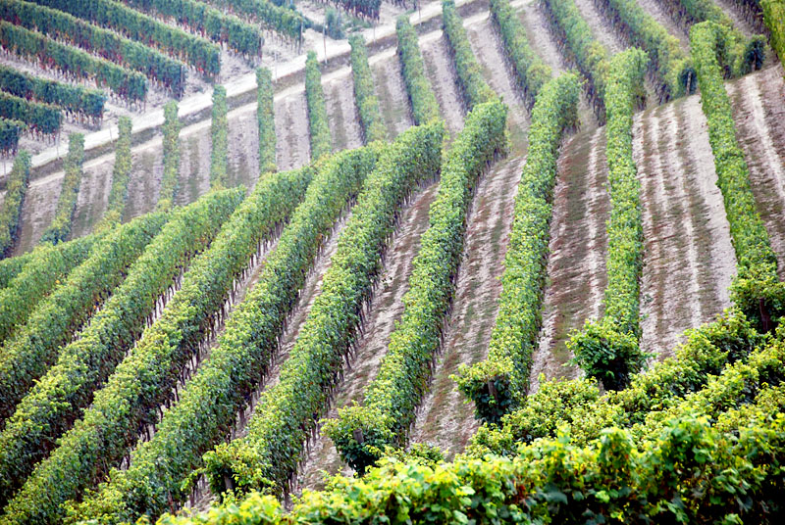

Slide 12
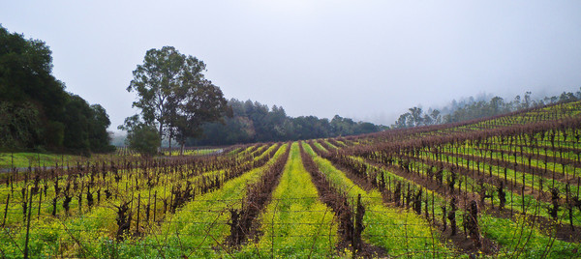
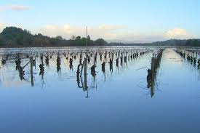

Slide 13
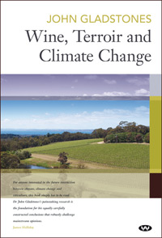

Slide 14
Cooperative Research Centre for Viticulture (Australia)
Nitrogen uptake by grapevines in relation to soil type and Irrigation method
6 different vineyards – nitrogen addition and recovery

Slide 15
DIFFERENT VINEYARDS

Slide 17
Canopy total N

Slide 18
ARE THERE SIMILAR VARIABLES WITH YAN VALUES?

Slide 19
Yeast Assimilable Nitrogen (YAN): Should YAN be measured each vintage year?
GRAPES FROM 8 VINEYARDS –
DATA OVER A 6-YEAR PERIOD

Slide 20
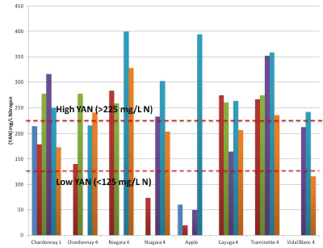

Slide 21
SPECIFICS – NITROGEN EFFECTS

Slide 22
LOW YAN MUSTS:
low yeast populations and poor fermentation
vigour, increased risk of sluggish/stuck/slow
fermentations, increased production of
undesirable thiols (e.g. hydrogen sulfide) and
higher alcohols, and low production of esters and long chain volatile fatty acids.
HIGH YAN MUSTS:
High must YAN leads to increased biomass and higher maximum heat output due to greater fermentation vigour, and increased formation of ethyl acetate, acetic acid and volatile acidity. Increased concentrations of haze-causing proteins, urea and ethyl carbamate and biogenic amines are also associated with high YAN musts.

Slide 23
LETS MAKE SOME WINE!

Slide 24
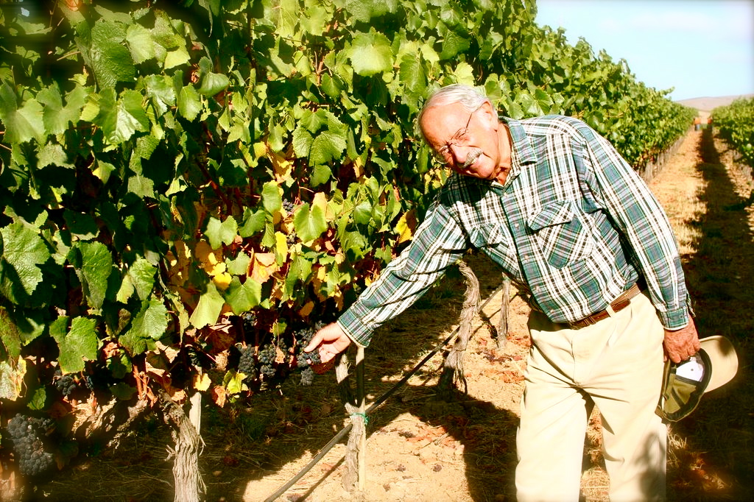
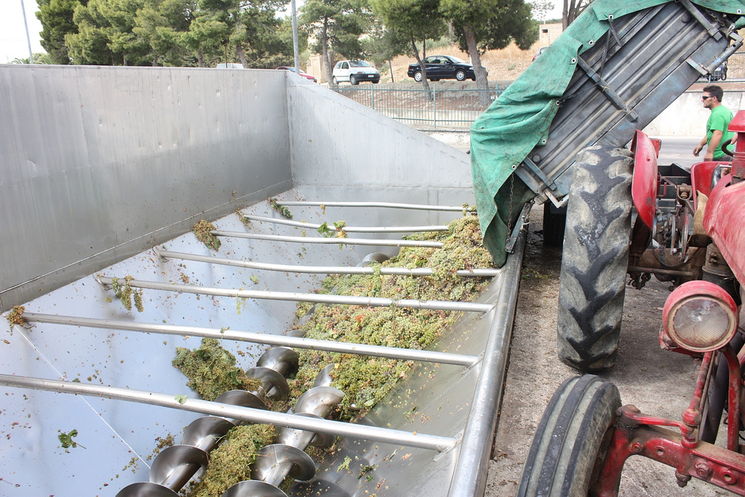
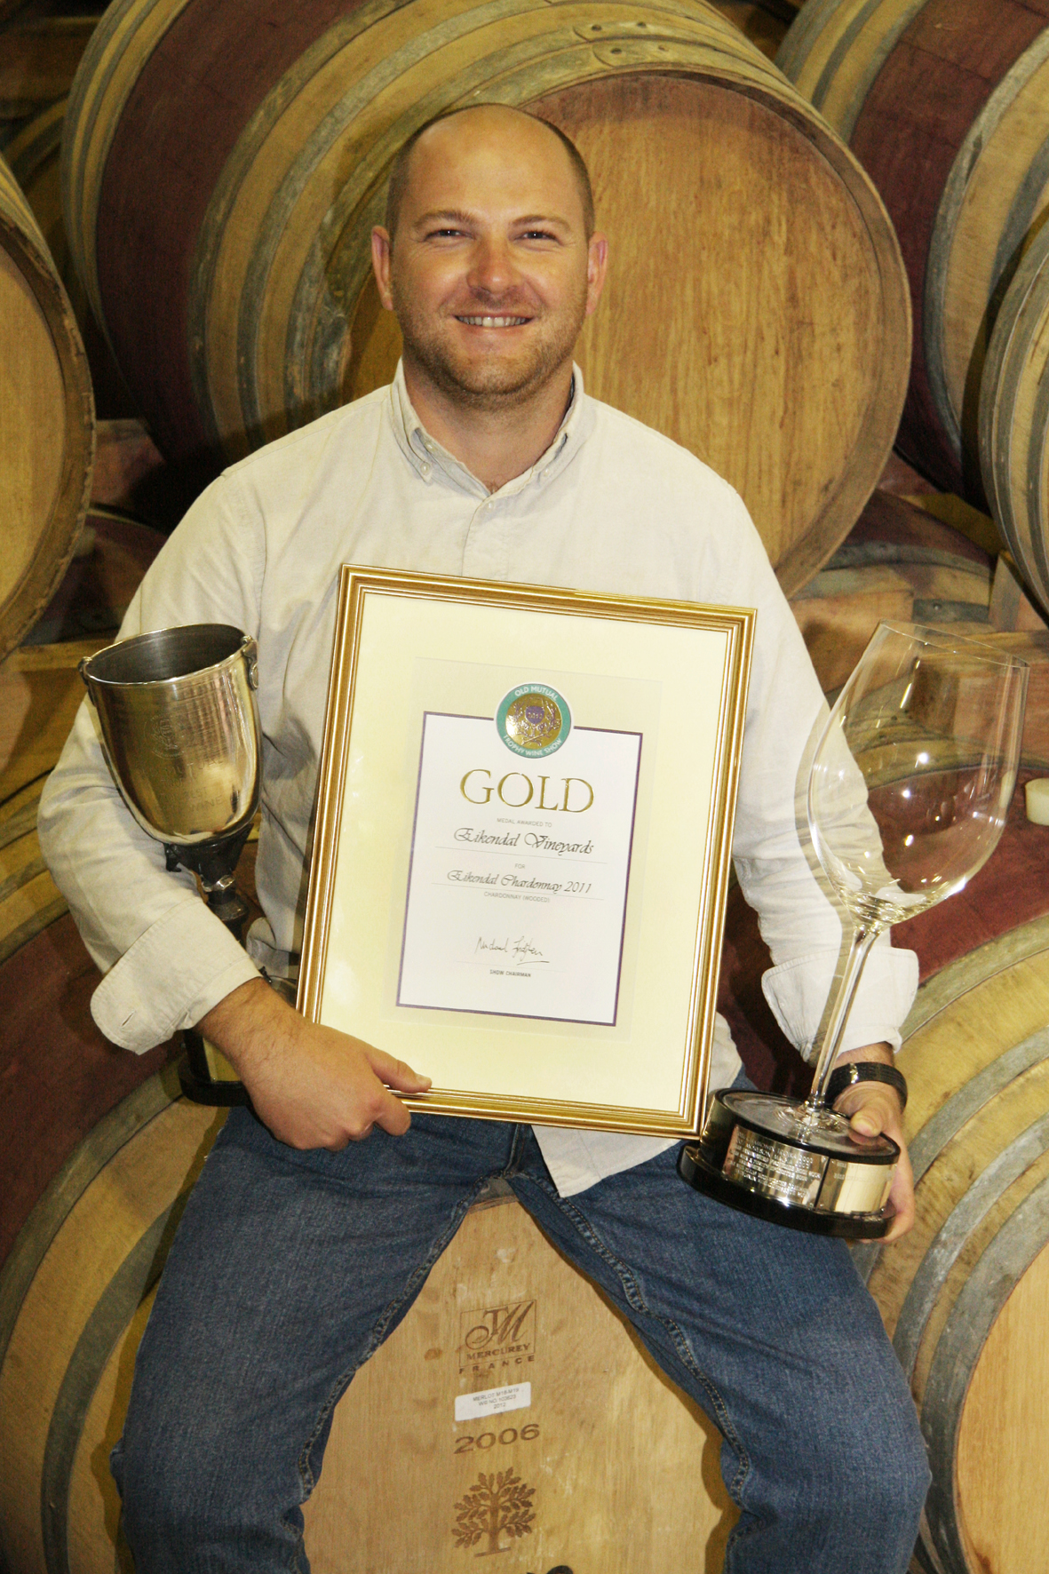
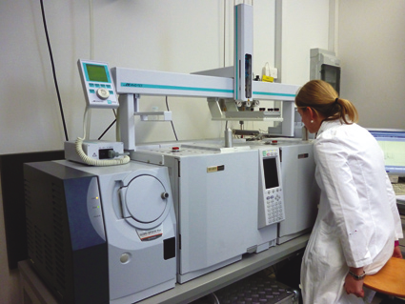

Slide 25
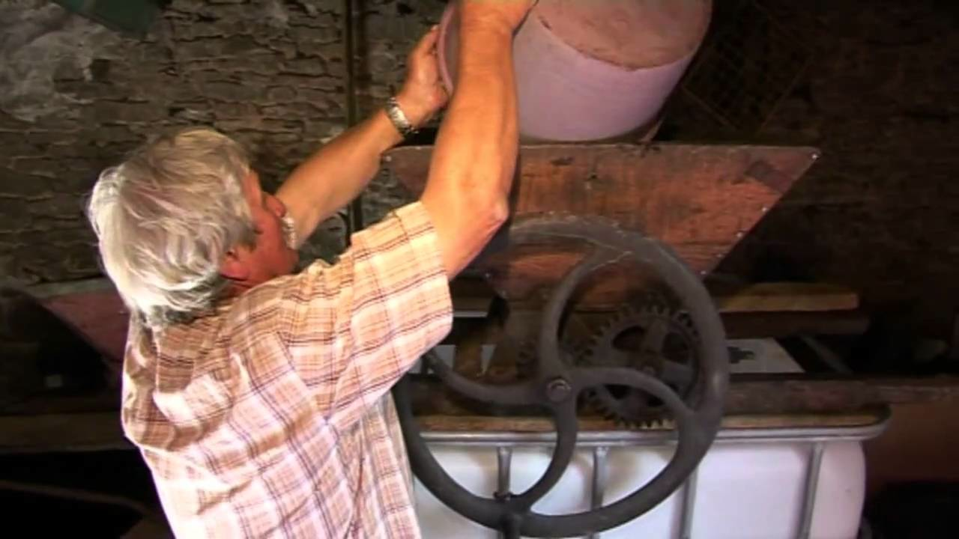

Slide 26
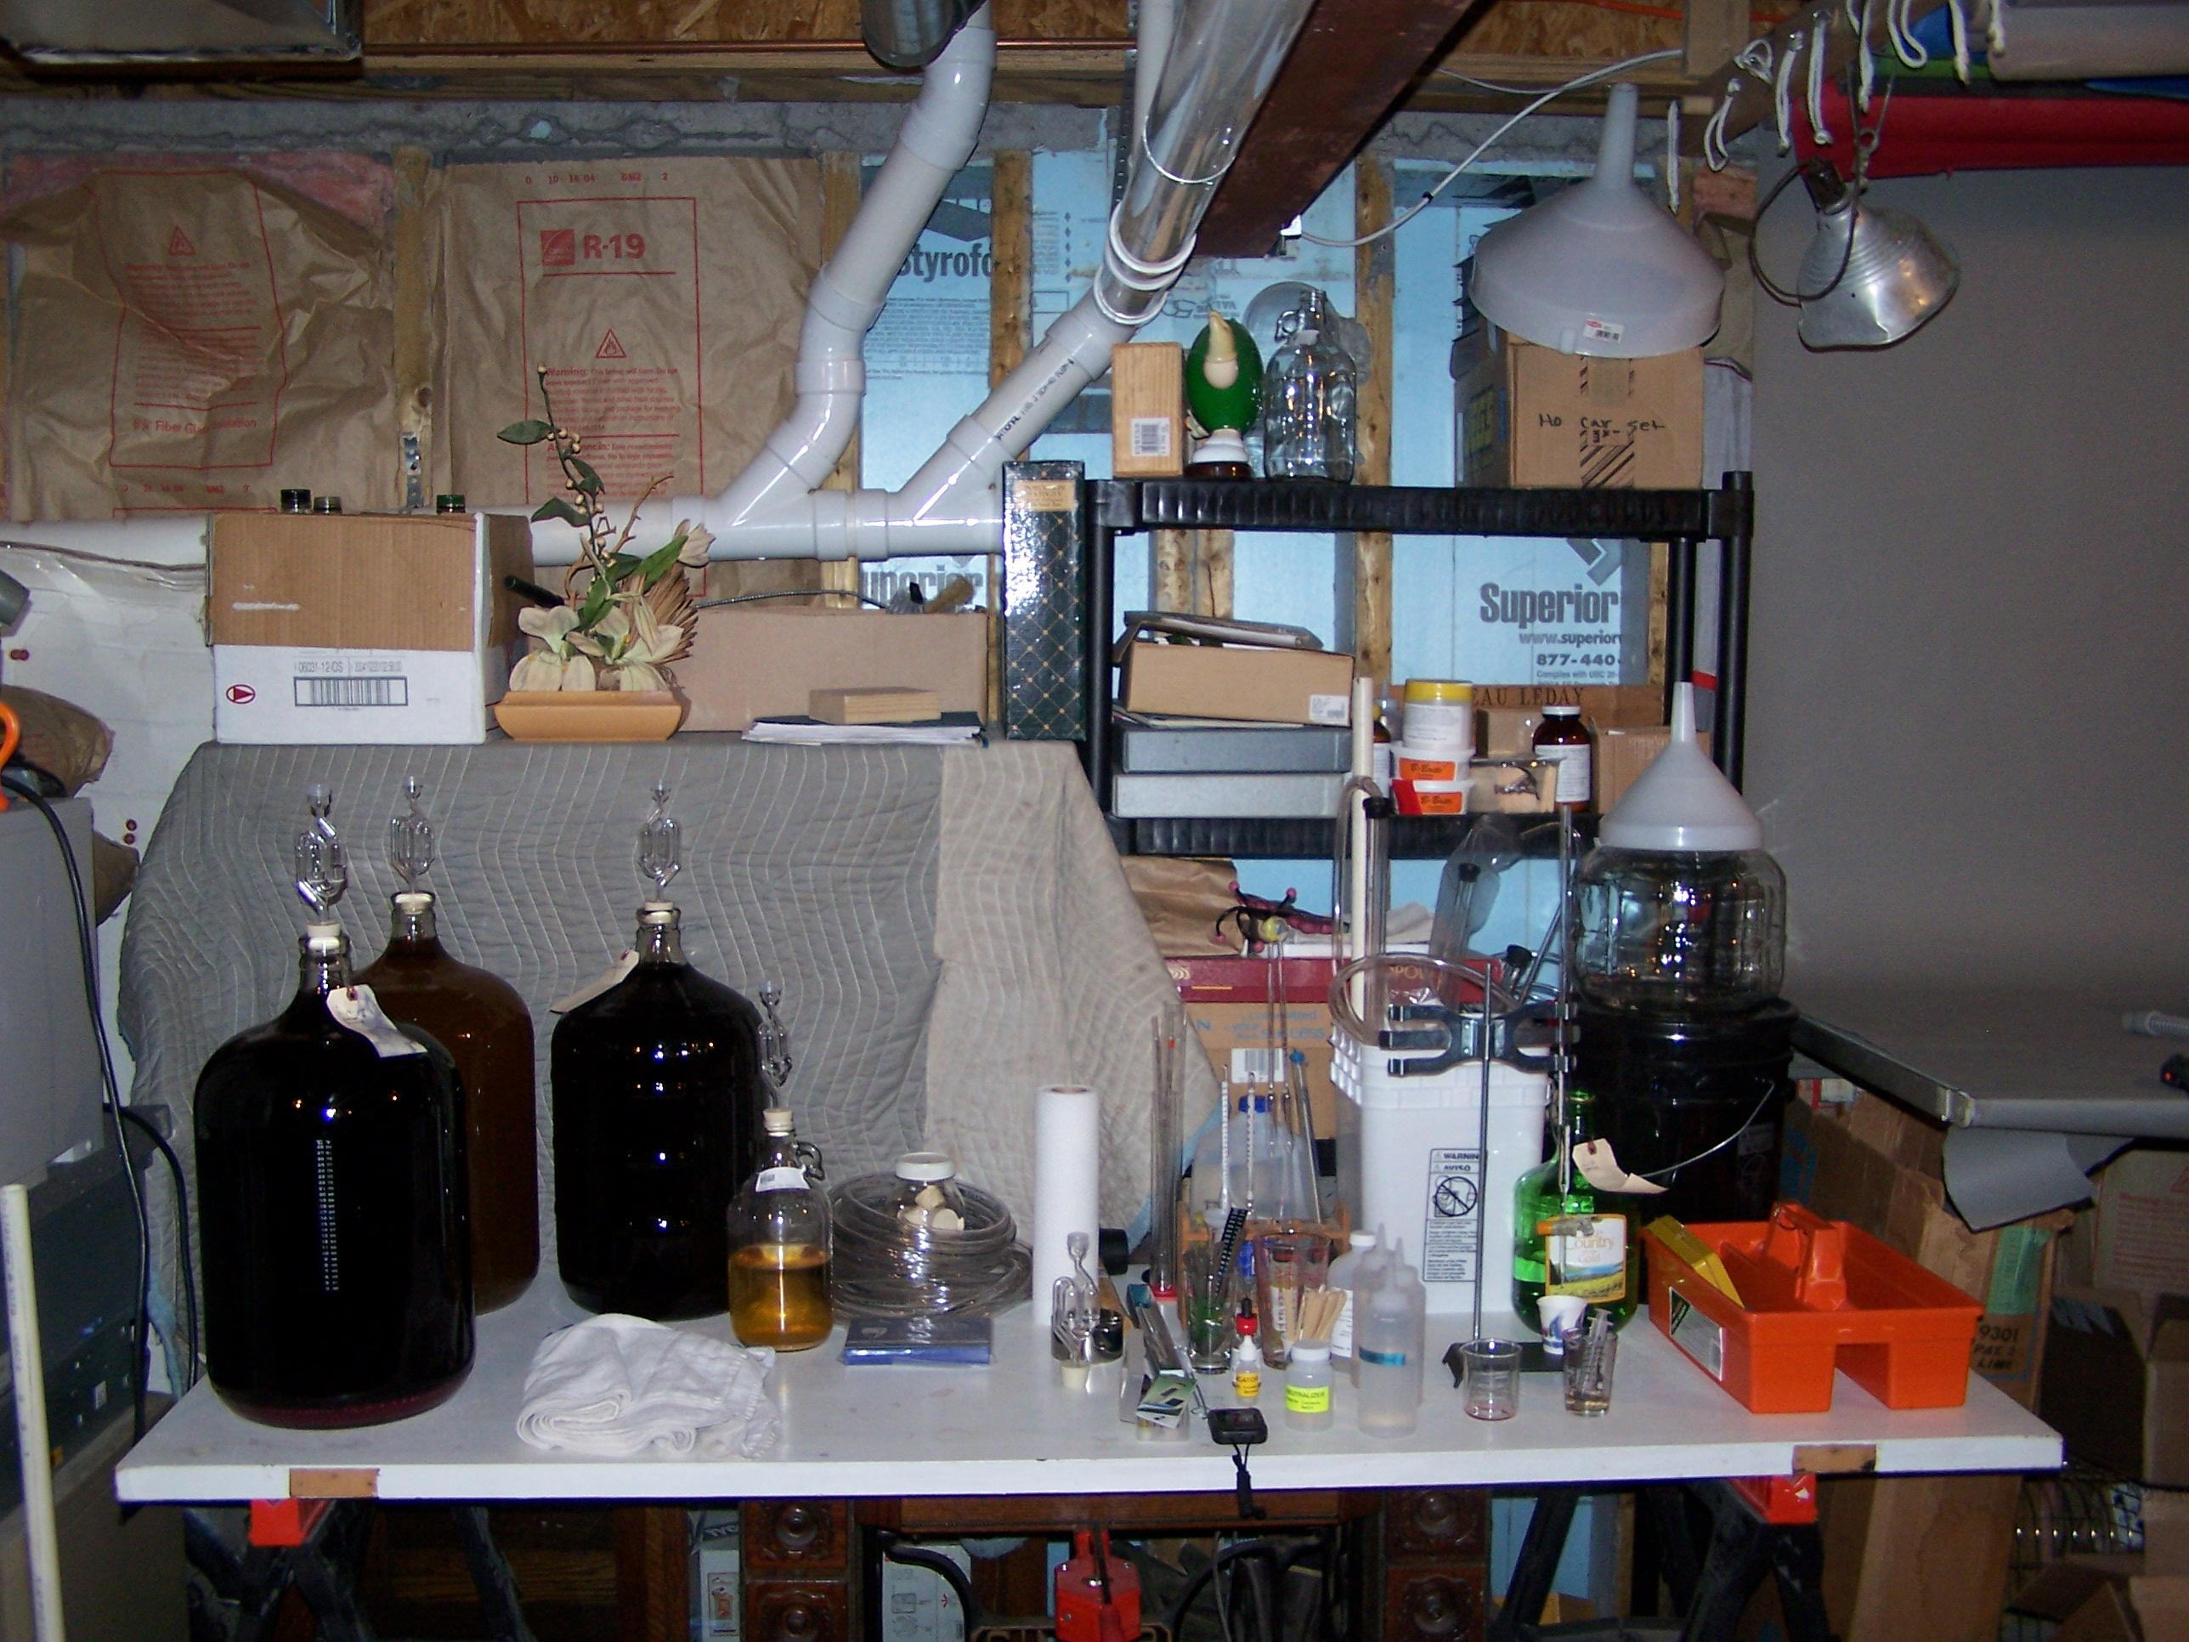

Slide 27
YAN

Slide 28
WHEN TO MEASURE YAN?

Slide 29
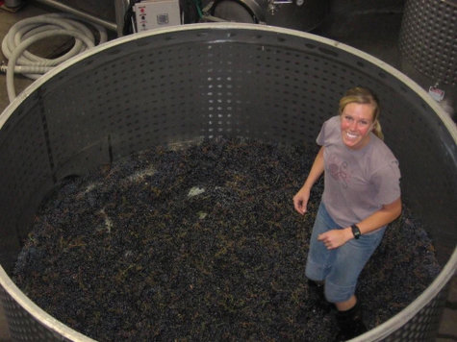
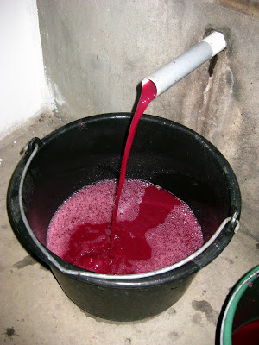
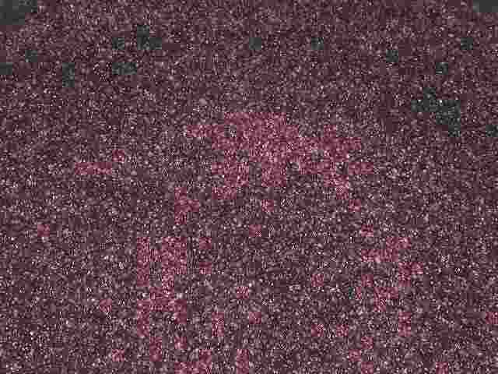

Slide 31
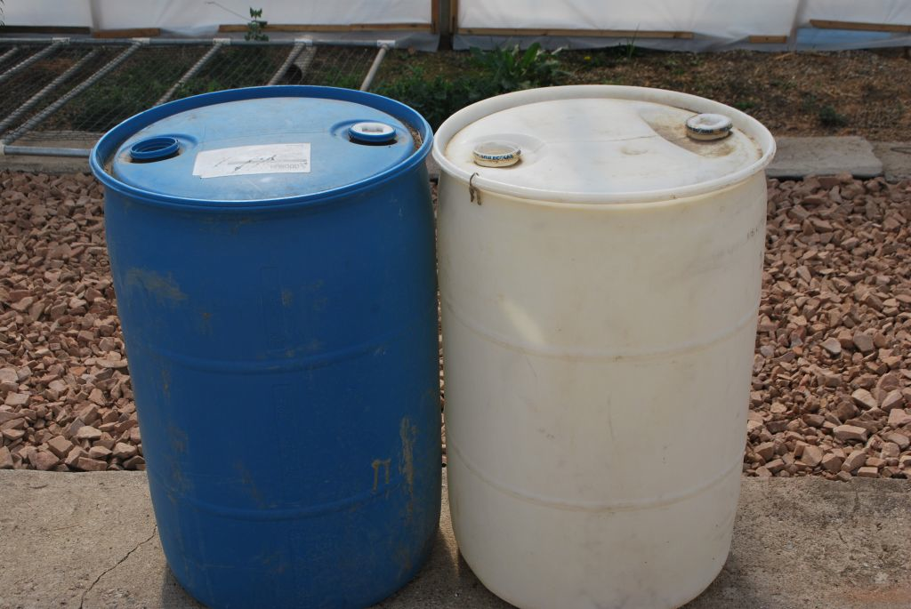
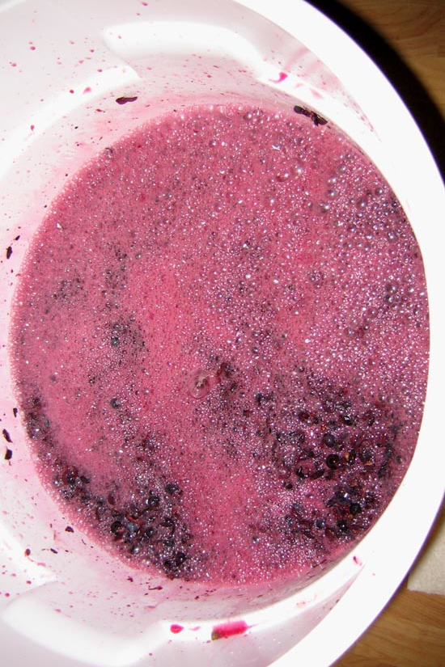
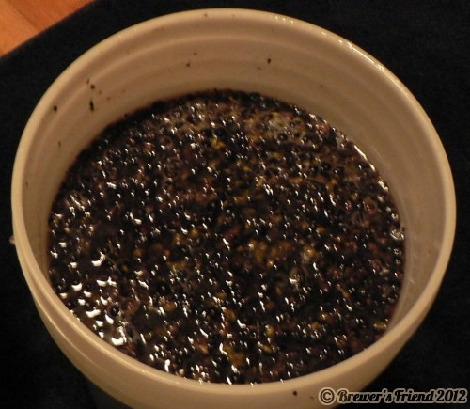

Slide 32
HOW MUCH NATIVE YAN HAS BEEN USED BY WILD YEAST?
DOES IT MATTER?

Slide 33
“...the amino acid profile of wines has a high discriminating ability, and can therefore be used as chemical tracer of product origin."
E. BOULOUMPASI et al., 2002: Vitis 41 (4), 195–202

Slide 34
How much YAN do they need?
At the start of fermentation
During fermentation

Slide 36
Nitrogen is most critically needed by yeast during the period of early cell growth through log phase and early stable development.

Slide 37
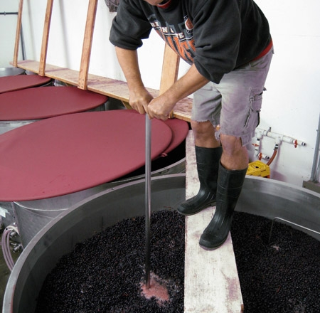

Slide 38
2011
Nutrient additions | BRIX | YAN | GOFERM | FERMAID K | FERMAID O | DAP | VIT END | TOTAL YAN/hL
Spenker Zin | 1.10 | 140 | 40 |  |  |  |  | 180
 | 1.08 |  |  | 40 | 20 | 25 | 30 | 115
 | 1.05 |  |  | 25 | 20 |  |  | 45
 |  |  |  |  |  |  | SUM | 340
SG

Slide 40
CAN WE USE YAN
LEVELS OVER TIME
TO HELP SELECT
GOOD VINEYARDS
OR IDENTIFY VINEYARDS
THAT ARE NOT SO GOOD?

Slide 41
YAN
400
300
200 |  | X |  | X
 | X |  | X |  | X
100
0
 | 1 | 2 | 3 | 4 | 5
 | YEARS OF YAN MEASUREMENT
YAN
400
300 |  | X |  |  | X
200 |  |  |  | X
 | X
100 |  |  | X
0
 | 1 | 2 | 3 | 4 | 5
 | YEARS OF YAN MEASUREMENT

Slide 43
WHY DO SOME COMMERCIAL
WINERIES FEEL
MEASUREMENT OF YAN IS
NOT IMPORTANT?

Slide 44
TAKE HOME CONCEPTS
1. In terms of wine making, nitrogen is considered second only to sugar in importance.
TAKE HOME CONCEPTS
2. Without nitrogen – but with sugar – wine yeast will reproduce for a short time but growth will be irregular --> (stuck fermentation) then growth will stop altogether.
1. In terms of wine making, nitrogen is considered second only to sugar in importance.
3. Without nitrogen, grape vines would never produce grapes. (Nitrogen is essential for protein formation.)
2. Without nitrogen – but with sugar – wine yeast will reproduce but growth will be irregular --> stuck fermentation.
4. With too much nitrogen, growth (vines & yeast) can be irregular.
Marcus Keller, 2005. Nitrogen – Friend or Foe of Wine Quality? September/October 2005 issue of Practical Winery & Vineyard Magazine. http://www.practicalwinery.com/SeptOct05/septoct05p24.htm
3. Without nitrogen, grape vines would never produce grapes. (Nitrogen is essential for protein formation.)
Maurizio Ugliano, Paul A. Henschke, Markus J. Herderich, Isak S. Pretorius, 2007. Nitrogen management is critical for wine flavour and style. Pp. 24-30, AWRI REPORT, WINE INDUSTRY JOURNAL > VOL 22 NO 6 > NOVEMBER / DECEMBER 2007 > www.winebiz.com.au
4. With too much nitrogen, growth (vines & yeast) can be irregular.

Slide 45
FOUR WINES:
2010 AGL-SPENKER ZIN – YAN = 196
2011 AGL-SPENKER ZIN – YAN = 140
2012 AGL-SPENKER ZIN – YAN = 353
2012 DW-SPENKER ZIN – YAN = 330

